Slide 1
ShadowDraw : Real-Time User Guidance for Freehand Drawing
Team Name : fun@images
Presented by : Ishan Bansal(201530193)
Swapnil Daga(201531063)
Mentor TA: Ashwin Pathak
Faculty: Prof. Ravi Kiran
Prof. Rajvi Shah

Slide 2
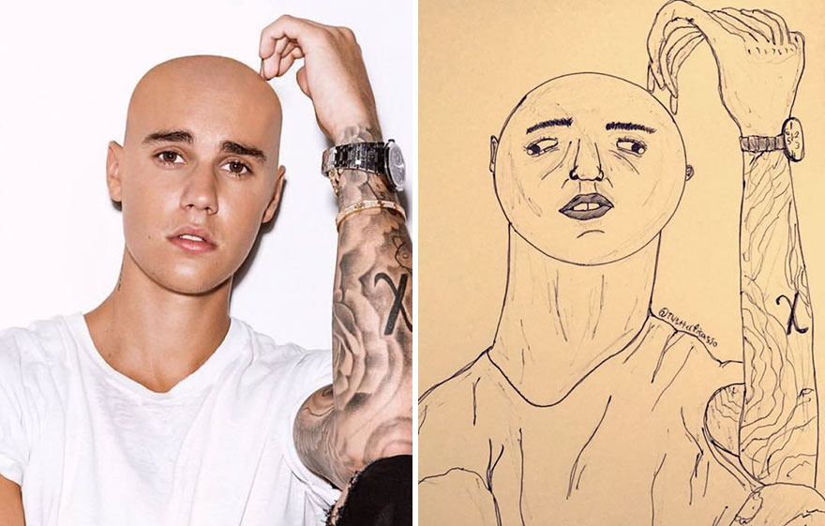
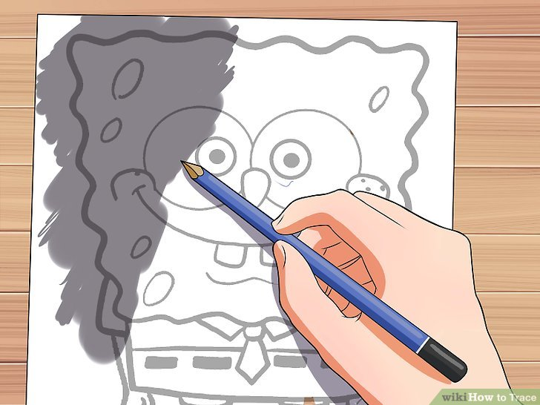
MOTIVATION & PROBLEM STATEMENT
Relative Size and Shape
Finding Images and Tracing

Slide 3
COMBINE BOTH OF THEM => ShadowDraw
Relative Size and Shape
Finding Images and Tracing

Slide 4
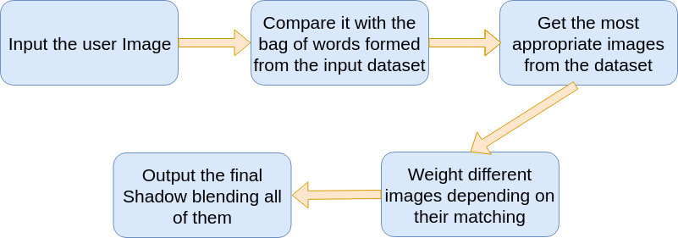
What does ShadowDraw Do ?

Slide 5
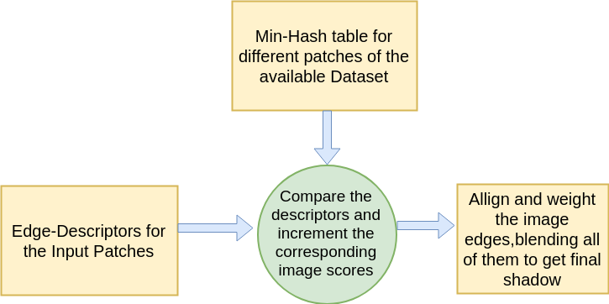
FLOWCHART

Slide 6
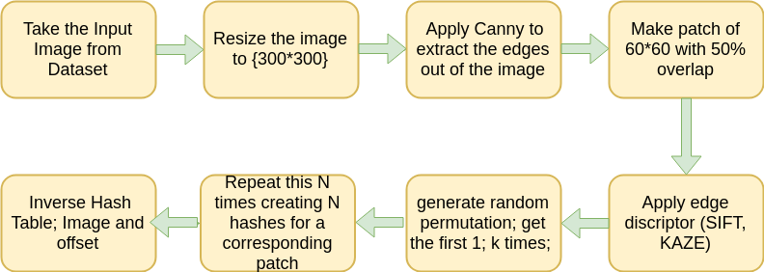
GETTING MIN-HASH

Slide 7
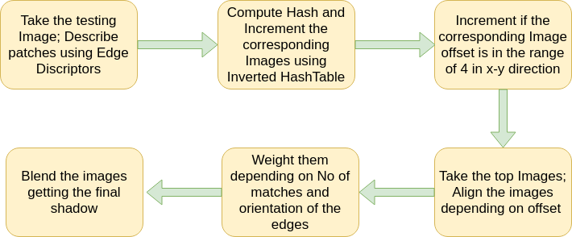
FORMING SHADOW

Slide 8
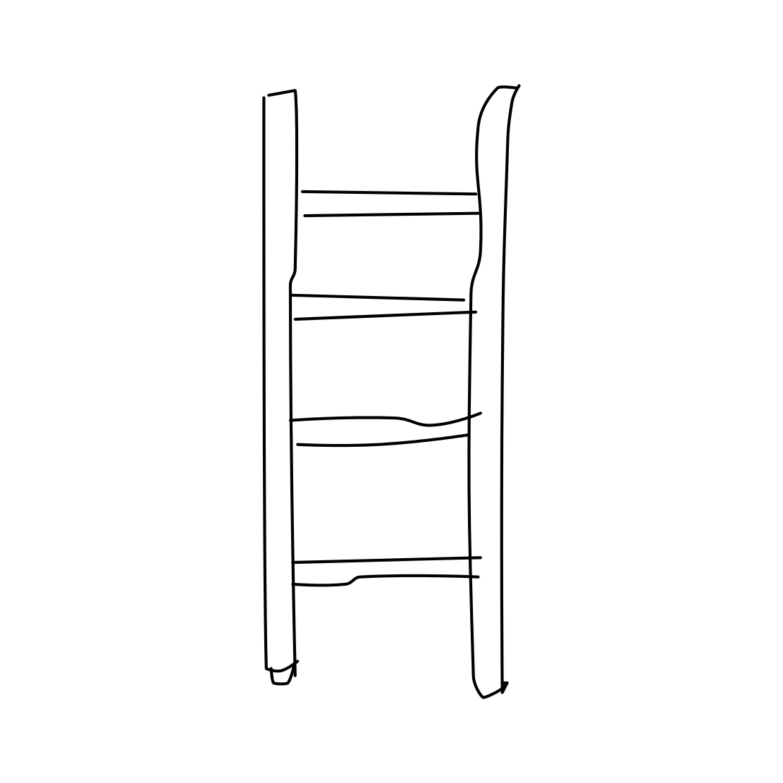
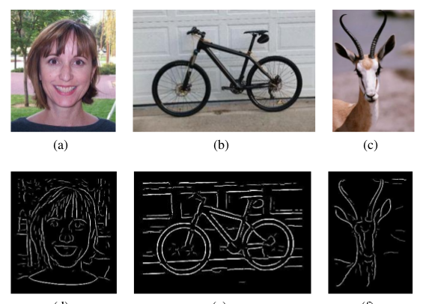
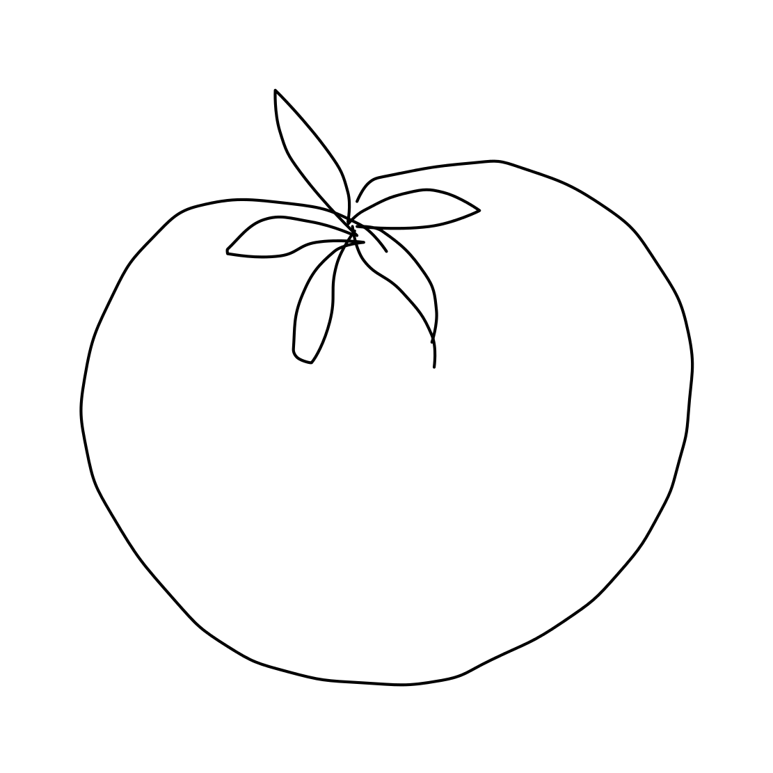

CHOOSING DATASET

Slide 9
SIFT/KAZE EDGE DESCRIPTOR
Take the 5 top Matches corresponding to each Edge Detector
Image Dataset : 3 categories ( Ladder, Moon, Tomato )
Test Dataset : 30 Images ( 15 Hand drawn/ 15 taken from dataset)
Notes:
Why not BICE?
No open source implementation available.
A research paper in itself!

Slide 10
SIFT/KAZE EDGE DESCRIPTOR
SIFT :
Correctly Predicted : 67%
Wrongly Predicted : 33%
Time taken : 51.136s
KAZE :
Correctly Predicted : 78%
Wrongly Predicted : 22%
Time taken : 1m13.110s
Notes:
Kaze is slower but gives better results. It performs better because it makes blurring in images locally adaptive to feature-points, thus reducing noise and simultaneously retaining the boundaries of regions in subject images. Kaze takes more time computationally because KAZE detector is based on scale normalized determinant of Hessian Matrix which is computed at multiple scale levels.

Slide 11
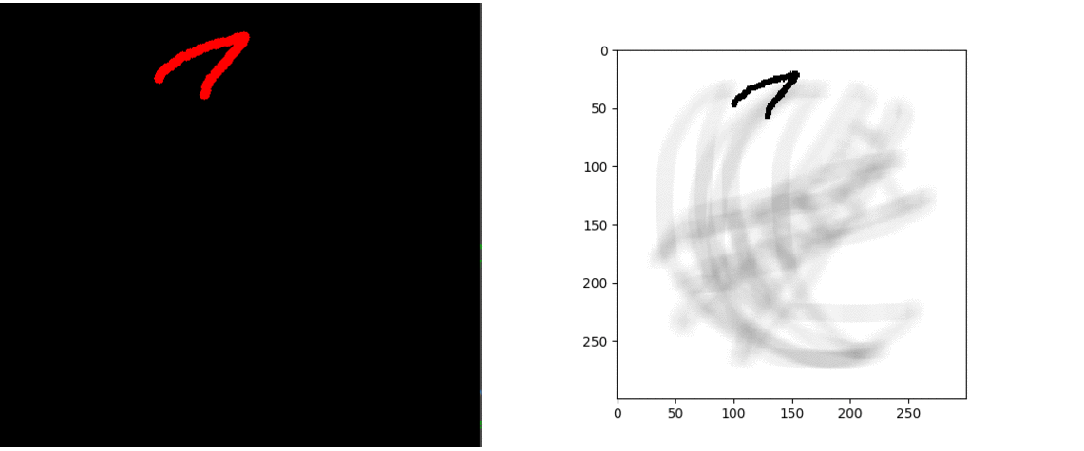
RESULTS
Notes:
GIF for Moon drawing

Slide 12
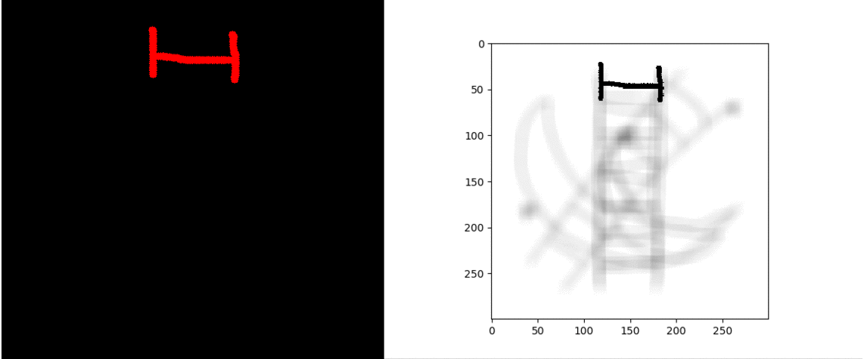
RESULTS
Notes:
GIF for Ladder sketches

Slide 13
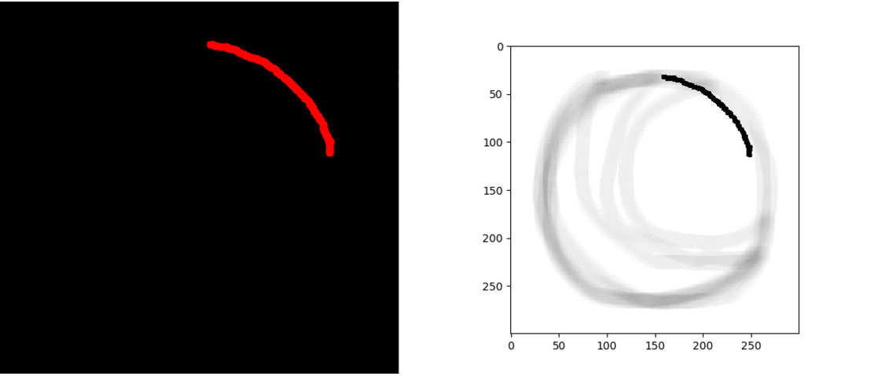
RESULTS
Notes:
GIF for tomato

Slide 14
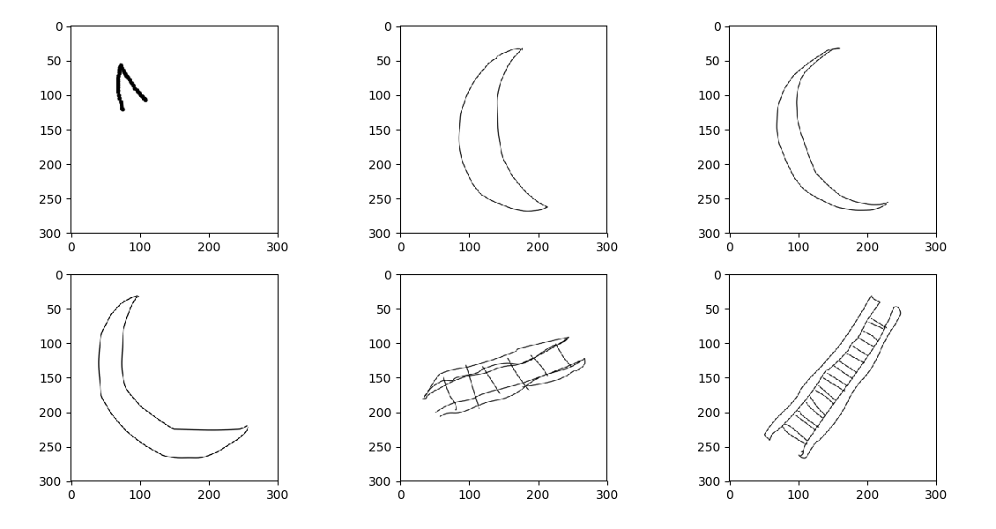
FAILURE CASES
WRONG PREDICTION :

Slide 15
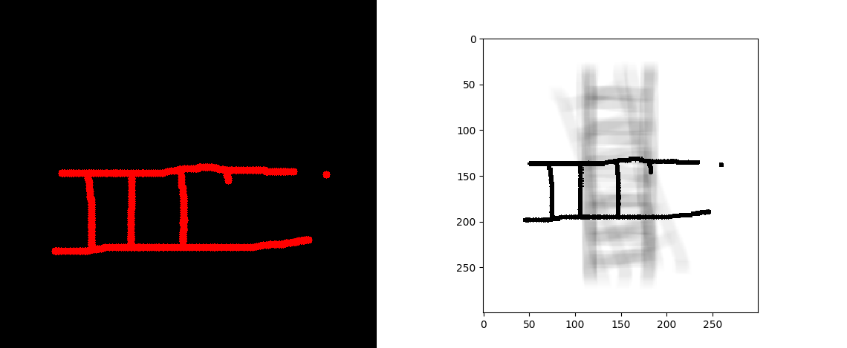
FAILURE CASES
WRONG ALLIGNMENT :

Slide 16
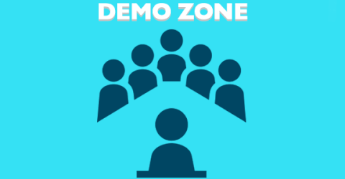

Slide 17
POSSIBLE IMPROVEMENTS/ FUTURE DIRECTIONS
Aligning the shadow edges in a single frame for better guidance to the user.
Testing on a larger dataset
More options to user for preferences
Use of parallelism and multithreading to remove limitations of tool and speedup the process.
Notes:
Currently interface does not accept user input while suggestions are displayed.

Slide 18
WORK DIVISION
Generating dataset - Ishan
Image Matching - Swapnil
Preparing the User interface - Ishan
Making software real-time and automating processes - Swapnil

Slide 19


